Slide 1
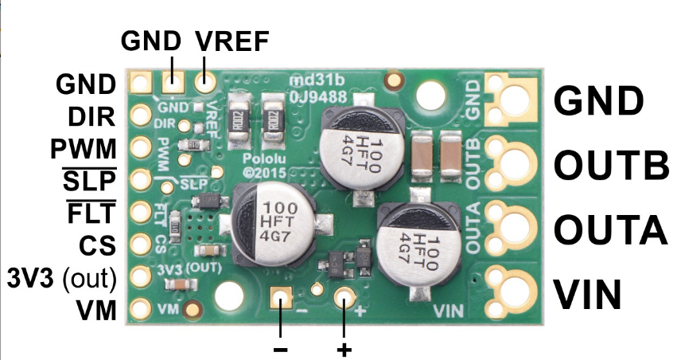
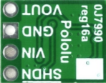
BOSS TORO Electromotive SA
Rev 1.3.1 UU (1 Aug 2020)
11.5 VDC
Mega-Watt
Model #
S-350-12
step4
MOTOR --
C4
4.7uF 50Vcc
C5
4.7uF 50Vcc
DIR pin to D7
PWM pin to D6
MOTOR ++
C1
1000uF 50VDC
5033
5033
A1325
A1325
5033
9v
C2
10uF
C3
4.7pF
A1325
See LED
R G B
A1325

